Slide 1
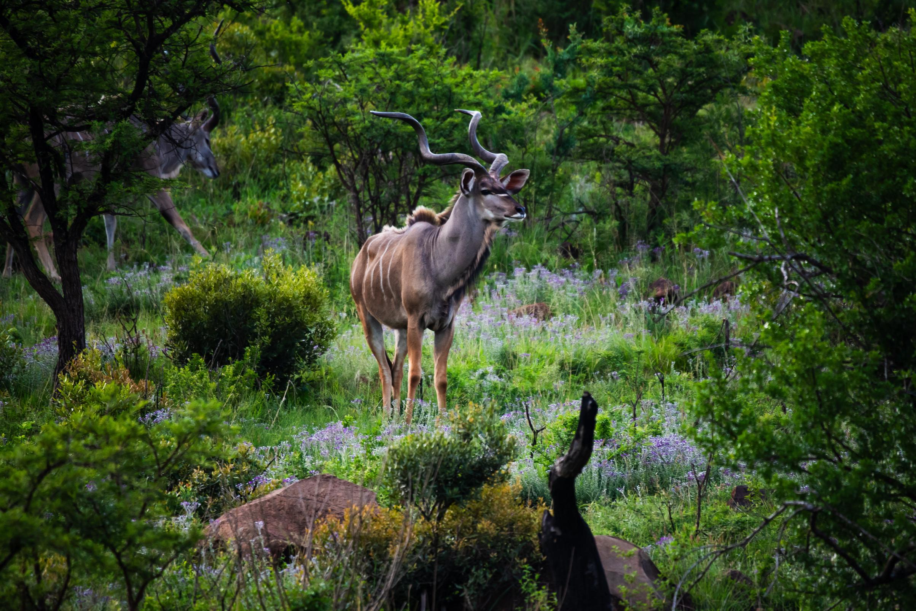

LOT 1
KUDU 40'- 45'
QUANTITY 2
CAPTURE DATES:
MAY 2025
PHOTOS TAKEN AT NAMBITI PRIVATE GAME RESERVE AS EXAMPLES

Slide 2
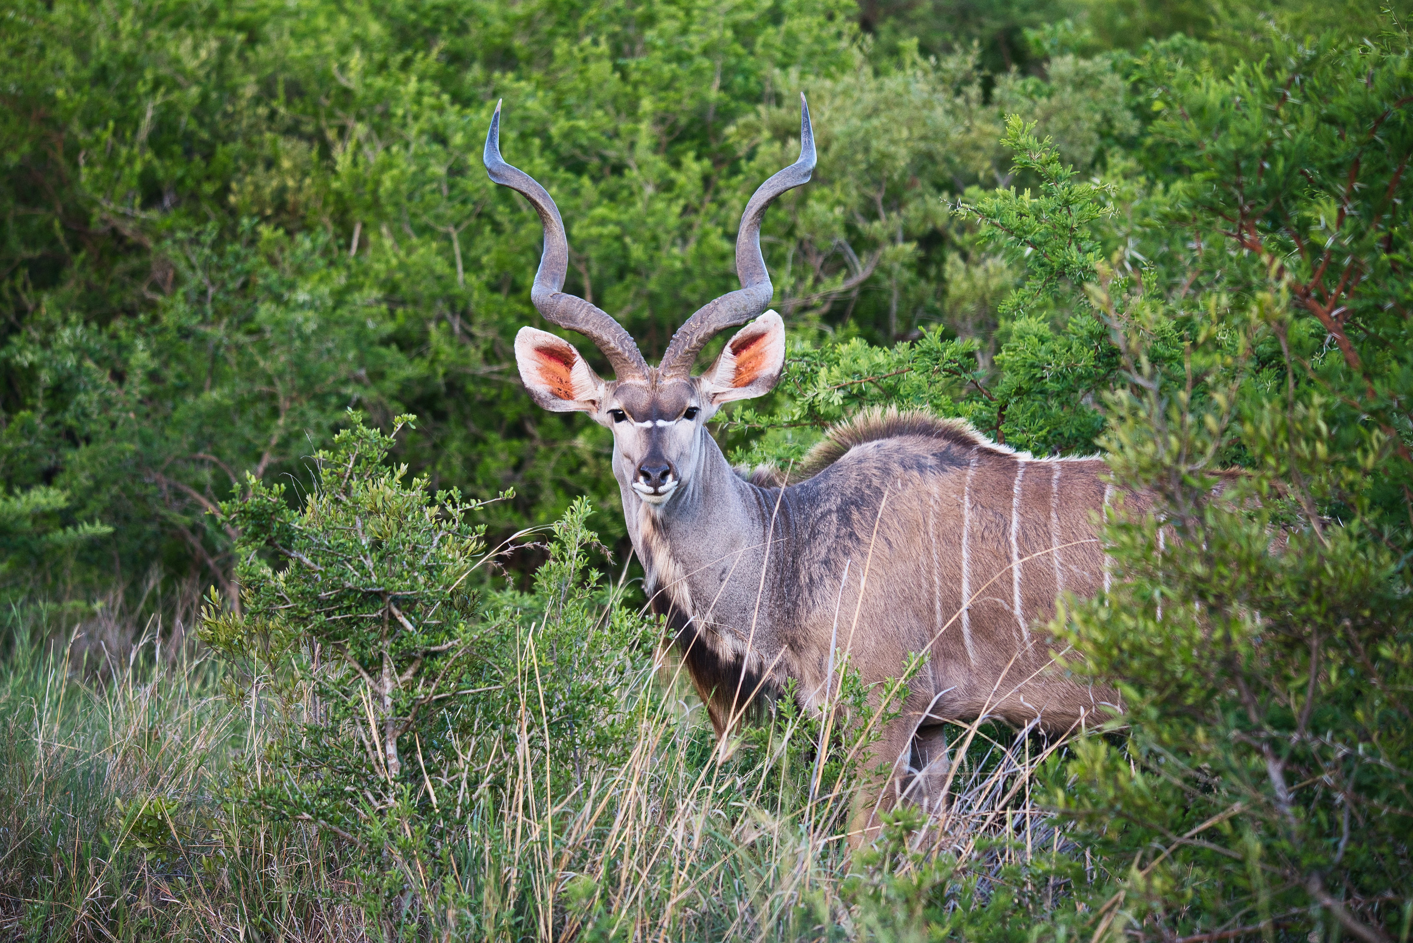
LOT 2
KUDU 40'- 45'
QUANTITY 2
CAPTURE DATES:
MAY 2025
PHOTOS TAKEN AT NAMBITI PRIVATE GAME RESERVE AS EXAMPLES

Slide 3
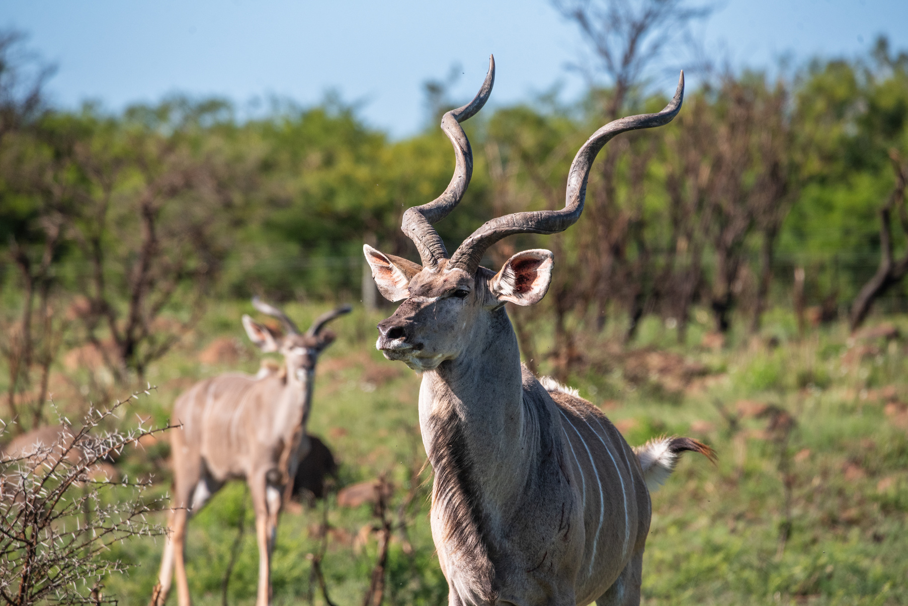
LOT 3
KUDU 46'- 49'
QUANTITY 1
CAPTURE DATES:
MAY 2025
PHOTOS TAKEN AT NAMBITI PRIVATE GAME RESERVE AS EXAMPLES

Slide 4
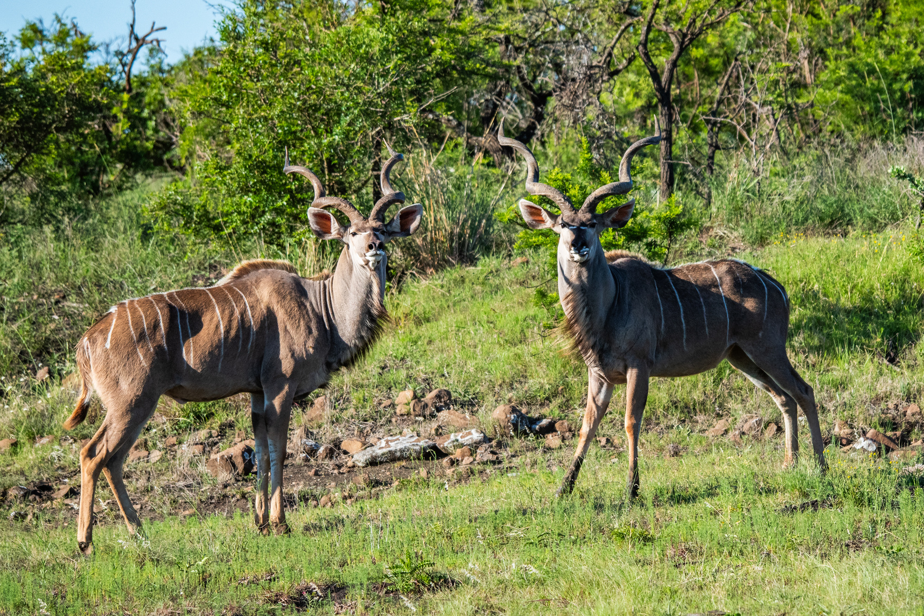
LOT 4
KUDU 46'- 49'
QUANTITY 1
CAPTURE DATES:
MAY 2025
PHOTOS TAKEN AT NAMBITI PRIVATE GAME RESERVE AS EXAMPLES

Slide 5
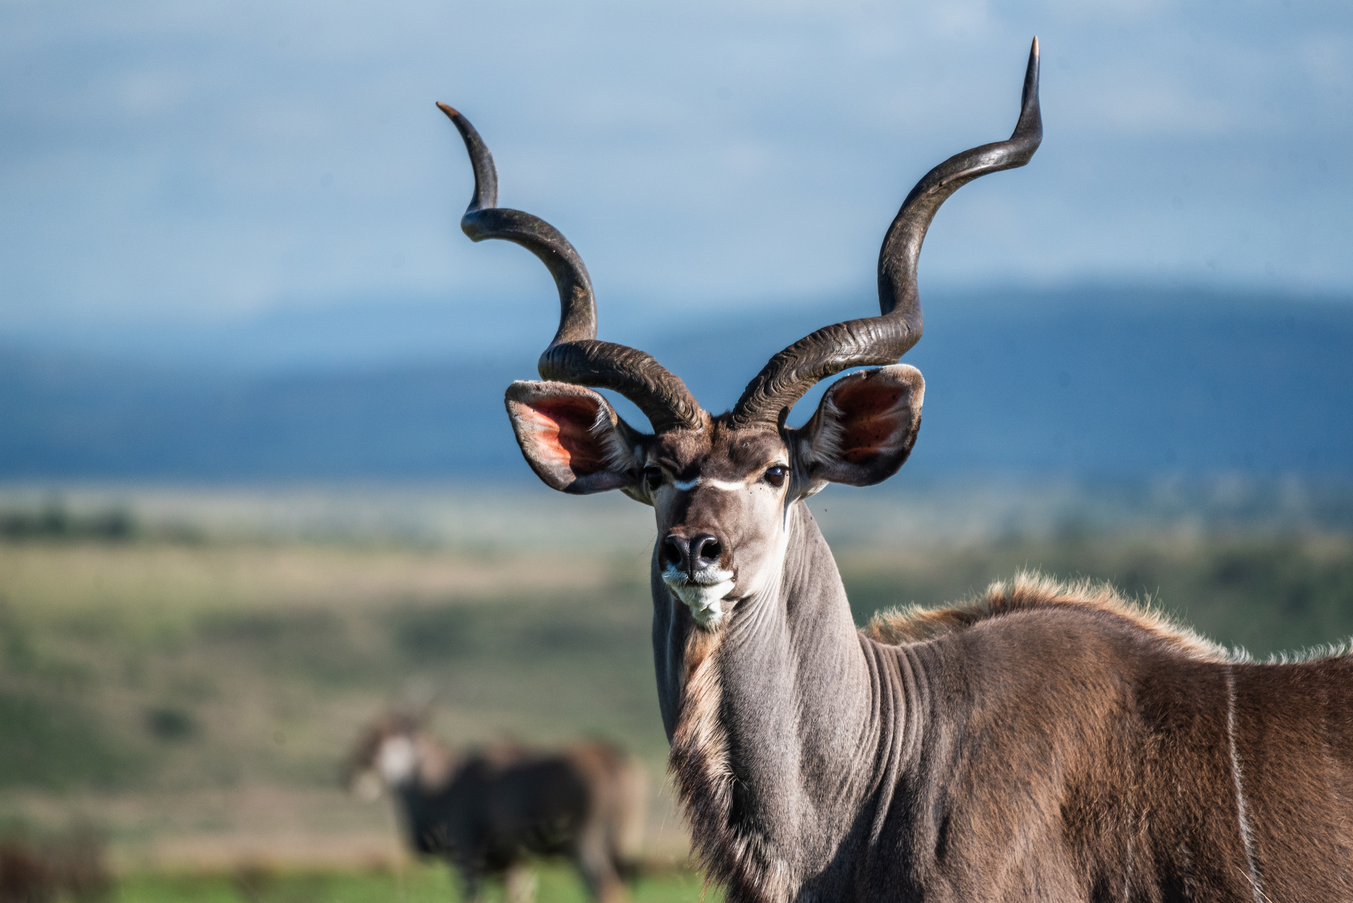
LOT 5
KUDU 46'- 49'
QUANTITY 1
CAPTURE DATES:
MAY 2025
PHOTOS TAKEN AT NAMBITI PRIVATE GAME RESERVE AS EXAMPLES

Slide 6
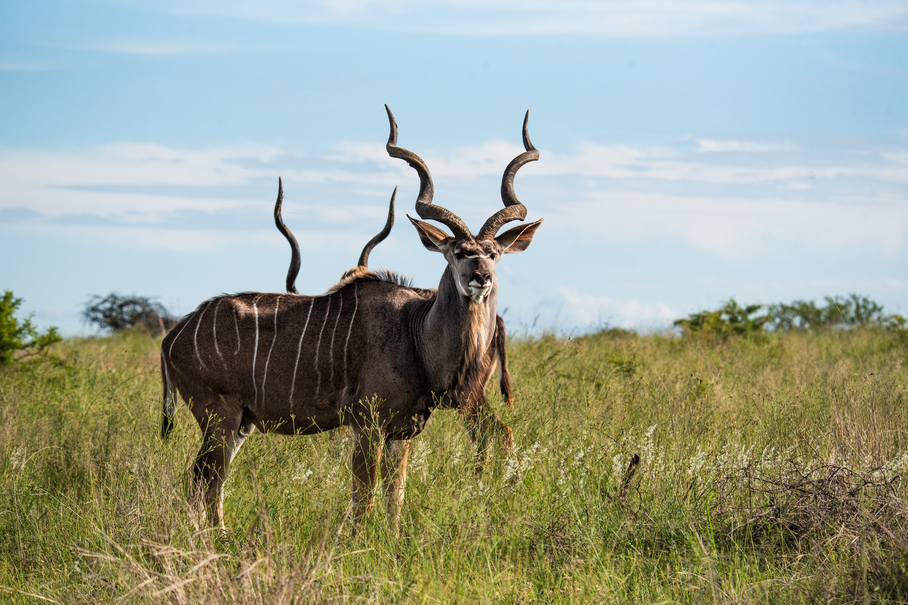
LOT 6
KUDU 46'- 49'
QUANTITY 1
CAPTURE DATES:
MAY 2025
PHOTOS TAKEN AT NAMBITI PRIVATE GAME RESERVE AS EXAMPLES

Slide 7
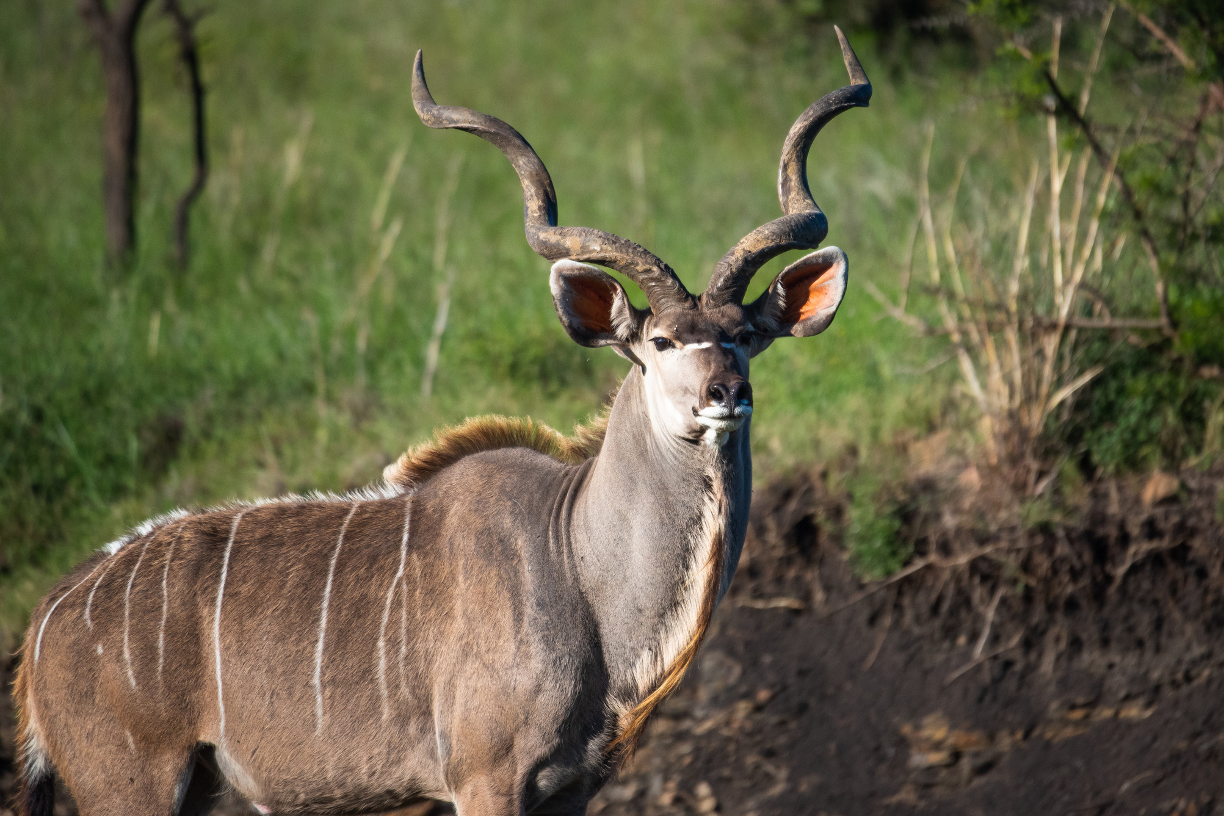
LOT 7
KUDU 50'+
QUANTITY 1
CAPTURE DATES:
MAY 2025
PHOTOS TAKEN AT NAMBITI PRIVATE GAME RESERVE AS EXAMPLES

Slide 8
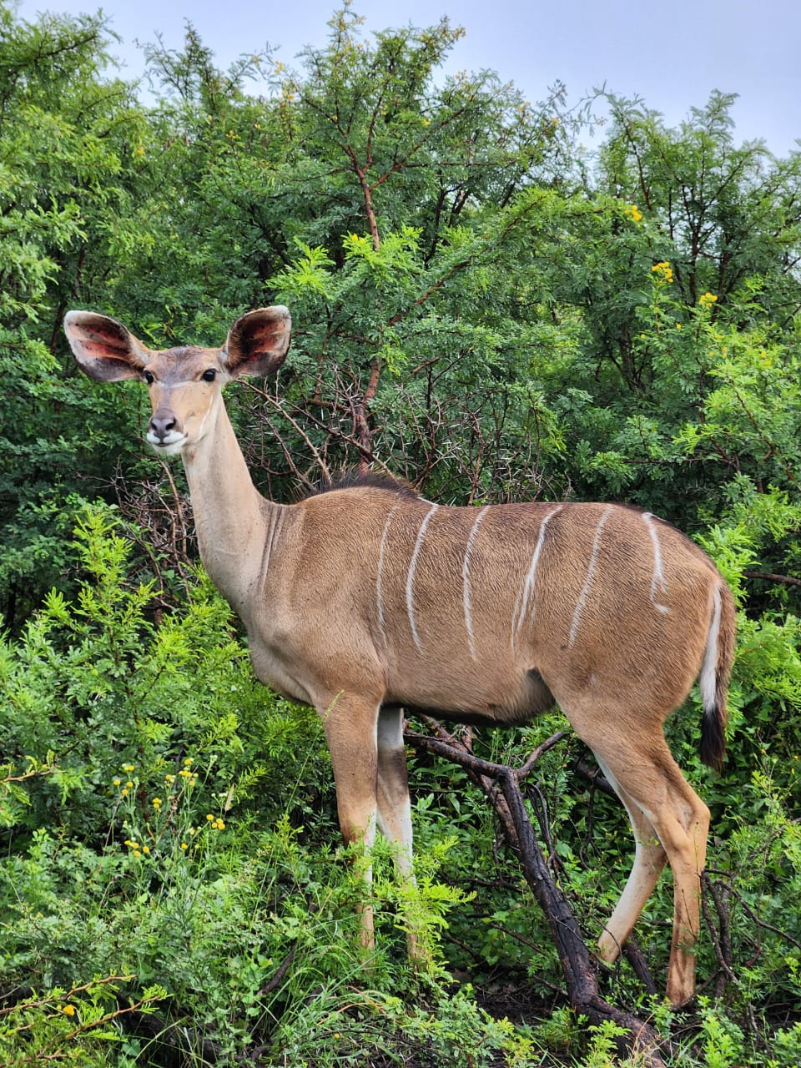
LOT 8
KUDU FAMILY GROUP
QUANTITY 8
CAPTURE DATES:
AUGUST 2025
PHOTOS TAKEN AT NAMBITI PRIVATE GAME RESERVE AS EXAMPLES

Slide 9
LOT 9
KUDU FAMILY GROUP
QUANTITY 8
CAPTURE DATES:
AUGUST 2025
PHOTOS TAKEN AT NAMBITI PRIVATE GAME RESERVE AS EXAMPLES

Slide 10
LOT 10
KUDU FAMILY GROUP
QUANTITY 8
CAPTURE DATES:
AUGUST 2025
PHOTOS TAKEN AT NAMBITI PRIVATE GAME RESERVE AS EXAMPLES

Slide 11
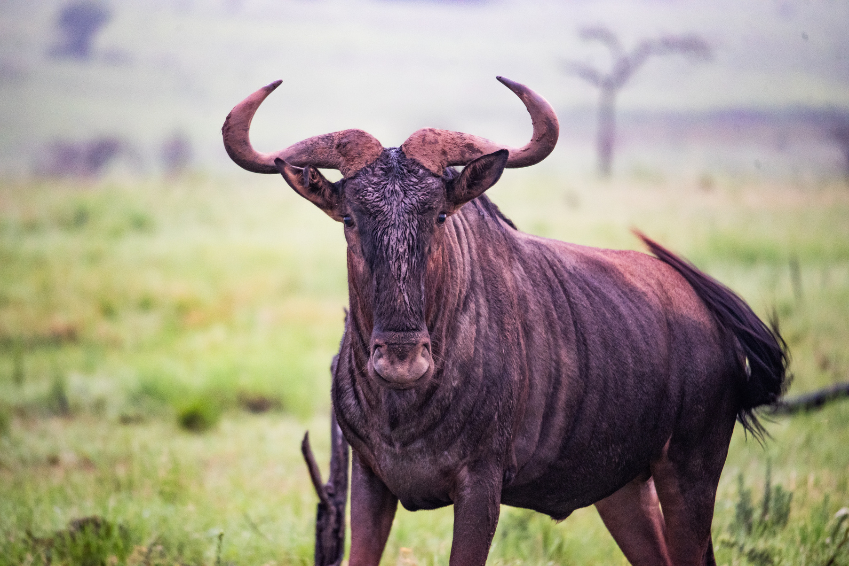
LOT 11
BLUE WILDEBEEST BULL 26'+
QUANTITY 1
CAPTURE DATES:
MAY 2025
PHOTOS TAKEN AT NAMBITI PRIVATE GAME RESERVE AS EXAMPLES

Slide 12
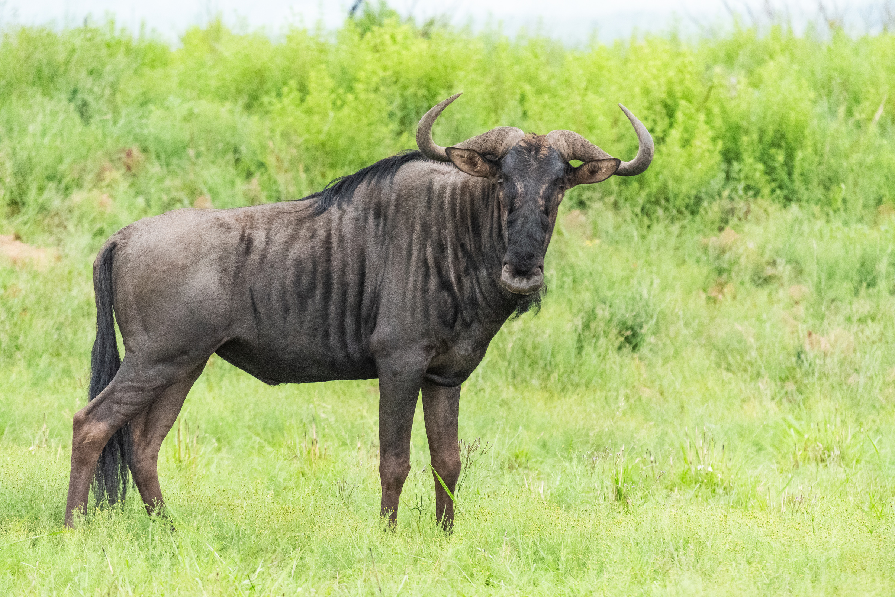
LOT 12
BLUE WILDEBEEST BULL 26'+
QUANTITY 2
CAPTURE DATES:
MAY 2025
PHOTOS TAKEN AT NAMBITI PRIVATE GAME RESERVE AS EXAMPLES

Slide 13
LOT 13
BLUE WILDEBEEST BULL 26'+
QUANTITY 4
CAPTURE DATES:
MAY 2025
PHOTOS TAKEN AT NAMBITI PRIVATE GAME RESERVE AS EXAMPLES

Slide 14
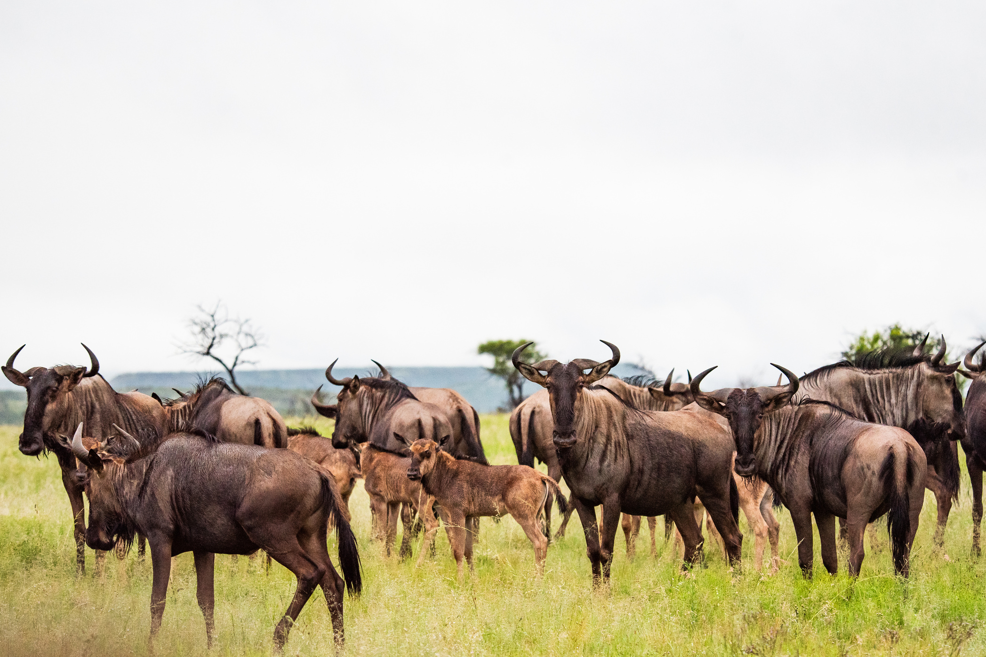
LOT 14
BLUE WILDEBEEST FAMILY
QUANTITY 8
CAPTURE DATES:
MAY 2025
PHOTOS TAKEN AT NAMBITI PRIVATE GAME RESERVE AS EXAMPLES

Slide 15
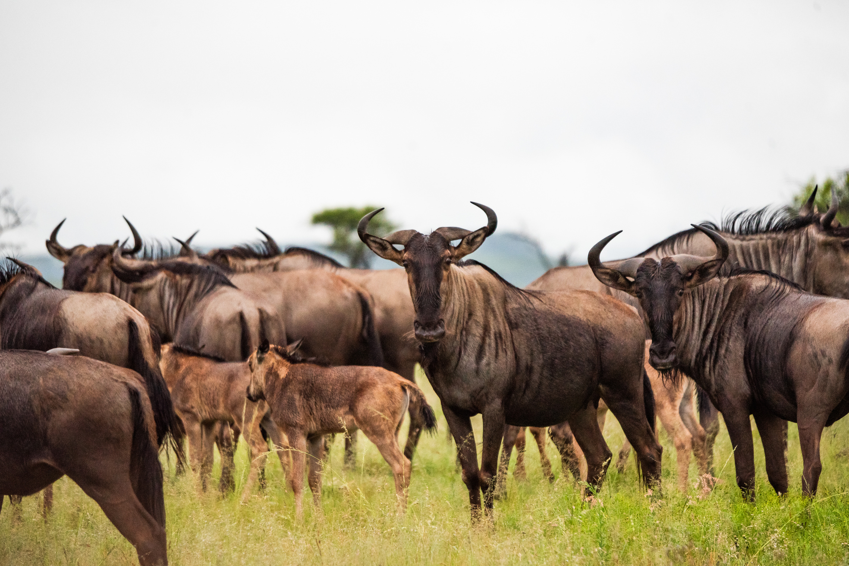
LOT 15
BLUE WILDEBEEST FAMILY
QUANTITY 8
CAPTURE DATES:
MAY 2025
PHOTOS TAKEN AT NAMBITI PRIVATE GAME RESERVE AS EXAMPLES

Slide 16
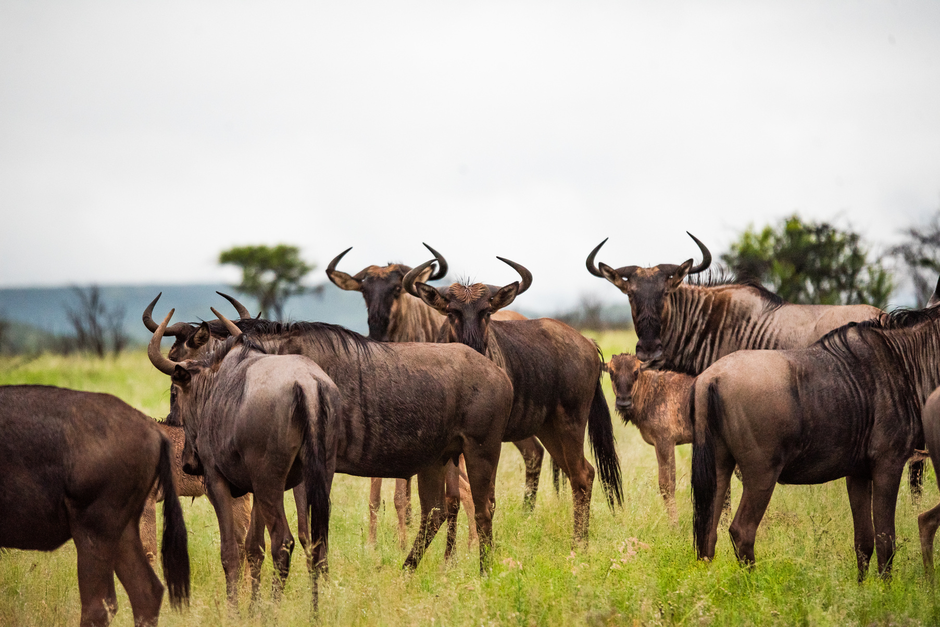
LOT 16
BLUE WILDEBEEST FAMILY
QUANTITY 8
CAPTURE DATES:
MAY 2025
PHOTOS TAKEN AT NAMBITI PRIVATE GAME RESERVE AS EXAMPLES

Slide 17
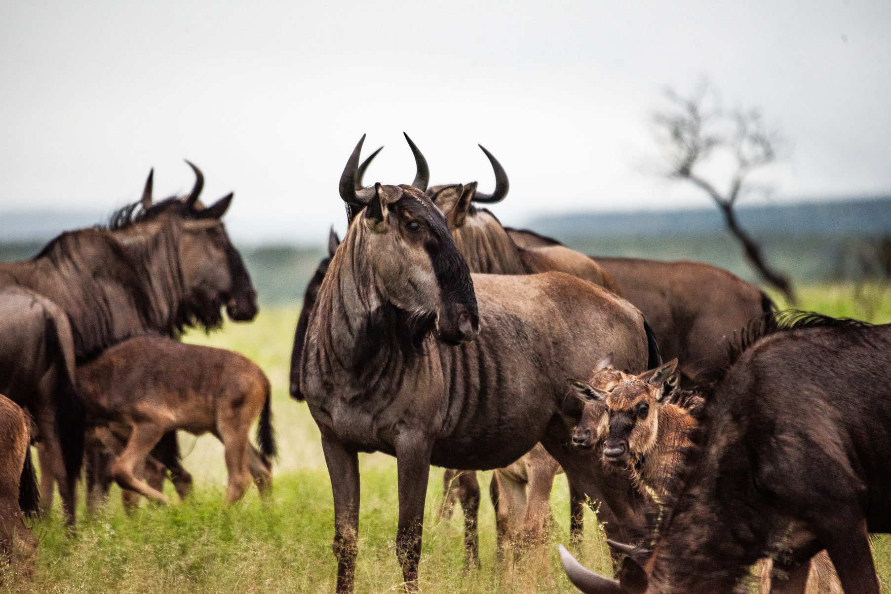
LOT 17
BLUE WILDEBEEST FAMILY
QUANTITY 8
CAPTURE DATES:
MAY 2025
PHOTOS TAKEN AT NAMBITI PRIVATE GAME RESERVE AS EXAMPLES

Slide 18
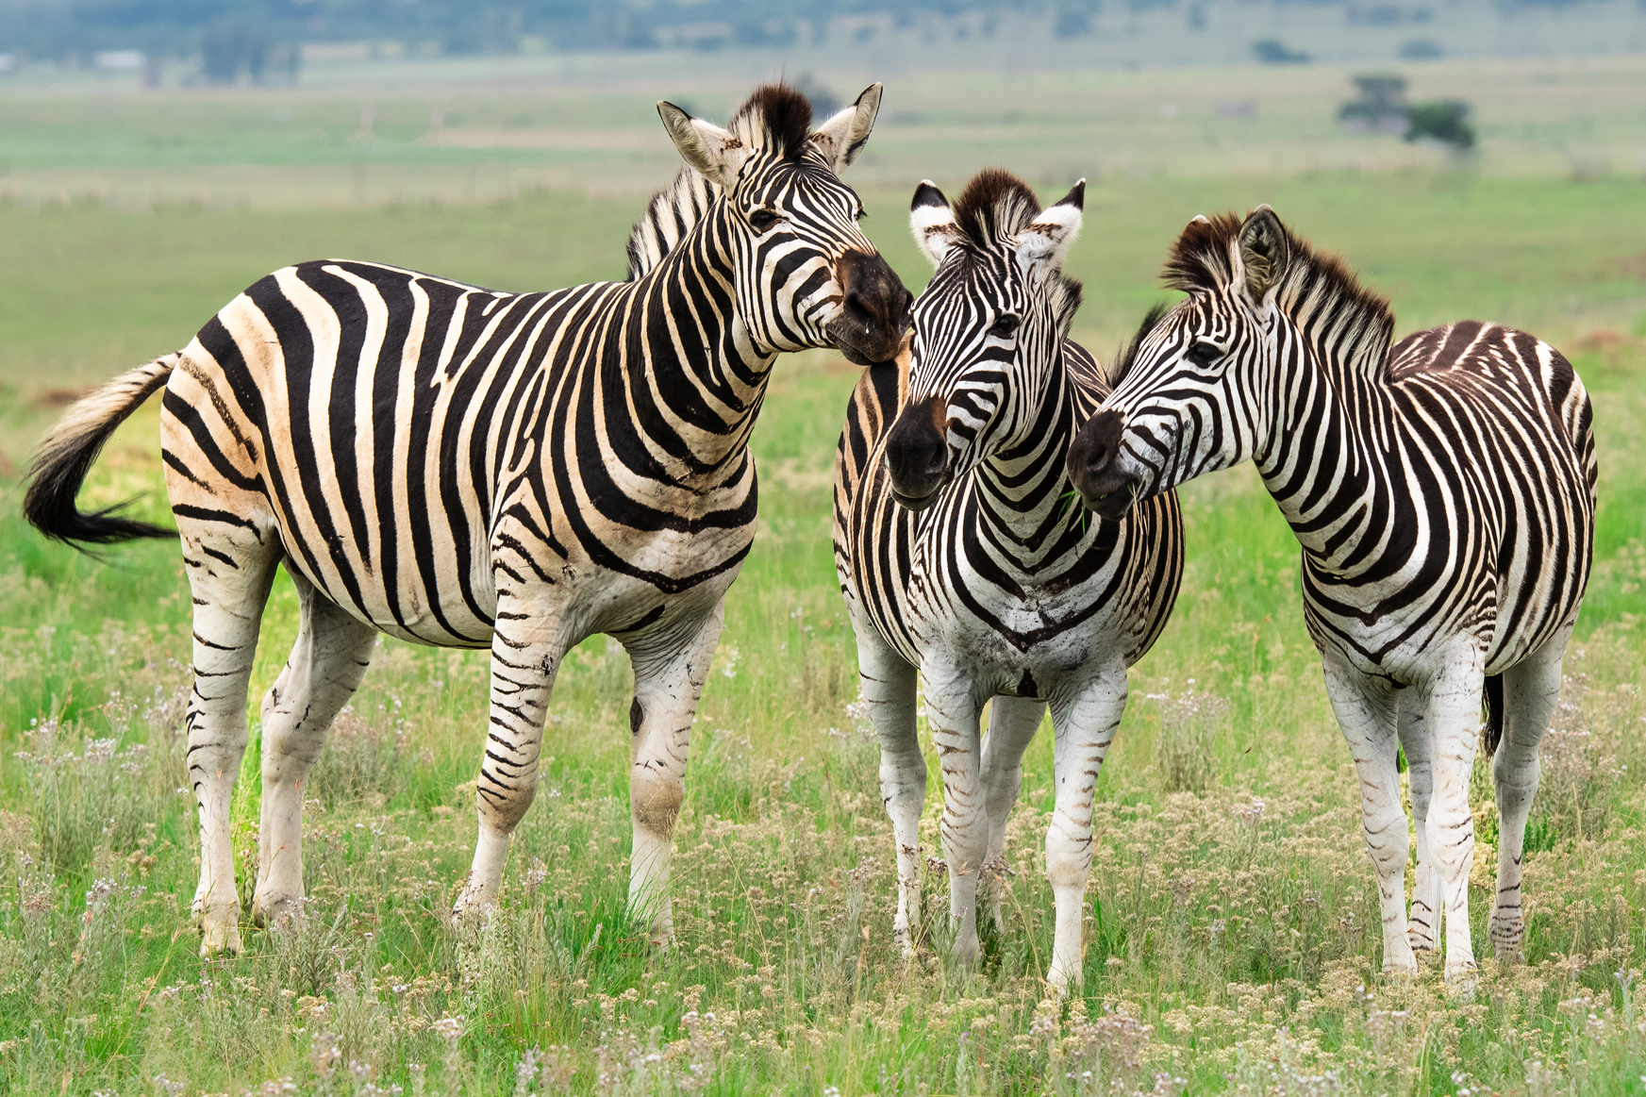
LOT 18
ZEBRA FAMILY GROUP
QUANTITY 6
CAPTURE DATES:
MAY 2025
PHOTOS TAKEN AT NAMBITI PRIVATE GAME RESERVE AS EXAMPLES

Slide 19
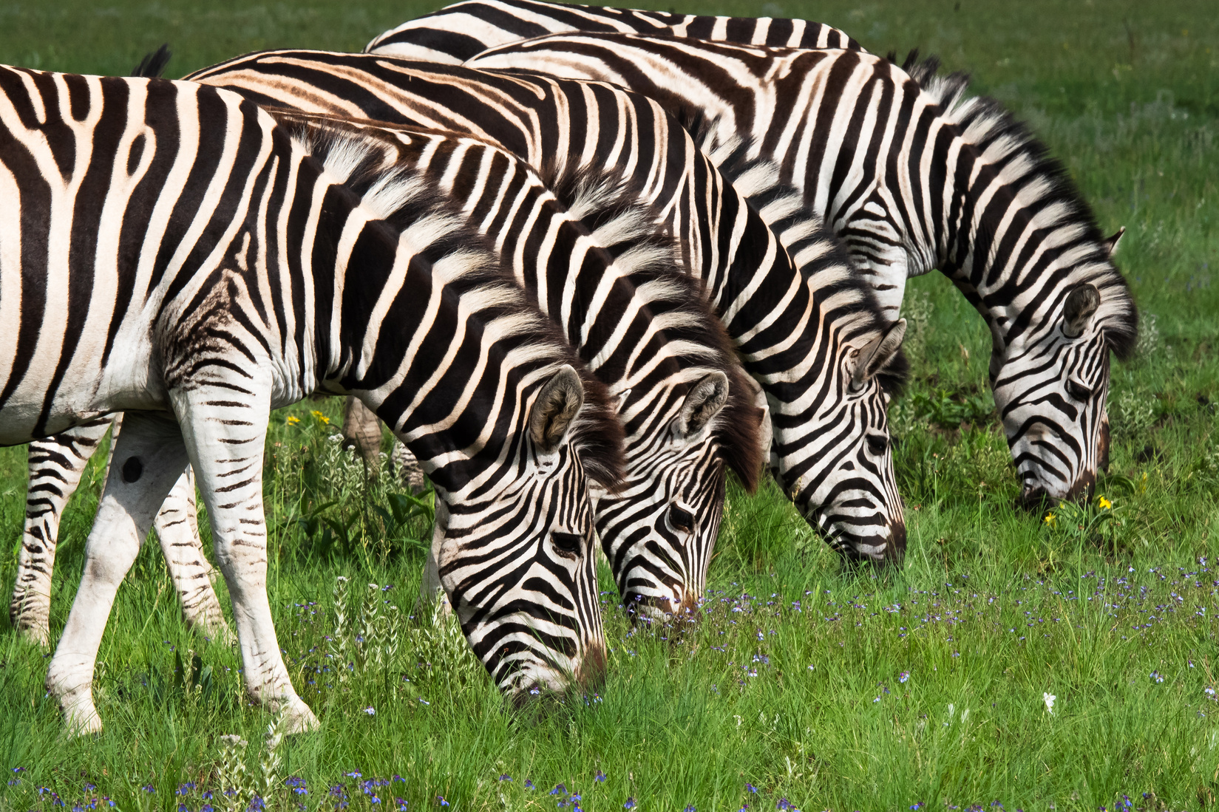
LOT 19
ZEBRA FAMILY GROUP
QUANTITY 6
CAPTURE DATES:
MAY 2025
PHOTOS TAKEN AT NAMBITI PRIVATE GAME RESERVE AS EXAMPLES

Slide 20
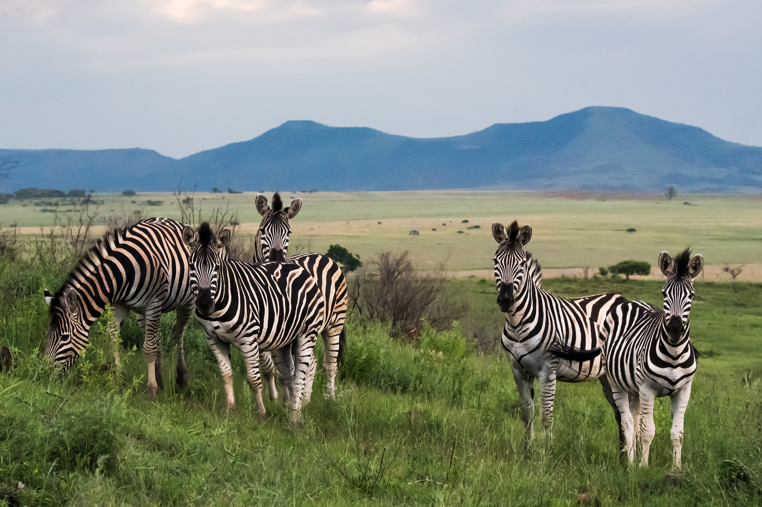
LOT 20
ZEBRA FAMILY GROUP
QUANTITY 6
CAPTURE DATES:
MAY 2025
PHOTOS TAKEN AT NAMBITI PRIVATE GAME RESERVE AS EXAMPLES

Slide 21
LOT 21
KUDU 40' - 45'
QUANTITY 2
CAPTURE DATES:
MAY 2025
PHOTOS TAKEN AT NAMBITI PRIVATE GAME RESERVE AS EXAMPLES

Slide 22
LOT 22
KUDU 40' - 45'
QUANTITY 2
CAPTURE DATES:
MAY 2025
PHOTOS TAKEN AT NAMBITI PRIVATE GAME RESERVE AS EXAMPLES

Slide 23
LOT 23
KUDU FAMILY GROUP
QUANTITY 6
CAPTURE DATES:
AUGUST 2025
PHOTOS TAKEN AT NAMBITI PRIVATE GAME RESERVE AS EXAMPLES

Slide 24
LOT 24
KUDU FAMILY GROUP
QUANTITY 6
CAPTURE DATES:
AUGUST 2025
PHOTOS TAKEN AT NAMBITI PRIVATE GAME RESERVE AS EXAMPLES

Slide 25
LOT 25
KUDU FAMILY GROUP
QUANTITY 6
CAPTURE DATES:
AUGUST 2025
PHOTOS TAKEN AT NAMBITI PRIVATE GAME RESERVE AS EXAMPLES

Slide 26
LOT 26
BLUE WILDEBEEST BULL 26'+
QUANTITY 1
CAPTURE DATES:
MAY 2025
PHOTOS TAKEN AT NAMBITI PRIVATE GAME RESERVE AS EXAMPLES

Slide 27
LOT 27
BLUE WILDEBEEST BULL 26'+
QUANTITY 2
CAPTURE DATES:
MAY 2025
PHOTOS TAKEN AT NAMBITI PRIVATE GAME RESERVE AS EXAMPLES

Slide 28
LOT 28
BLUE WILDEBEEST BULL 26'+
QUANTITY 6
CAPTURE DATES:
MAY 2025
PHOTOS TAKEN AT NAMBITI PRIVATE GAME RESERVE AS EXAMPLES

Slide 29
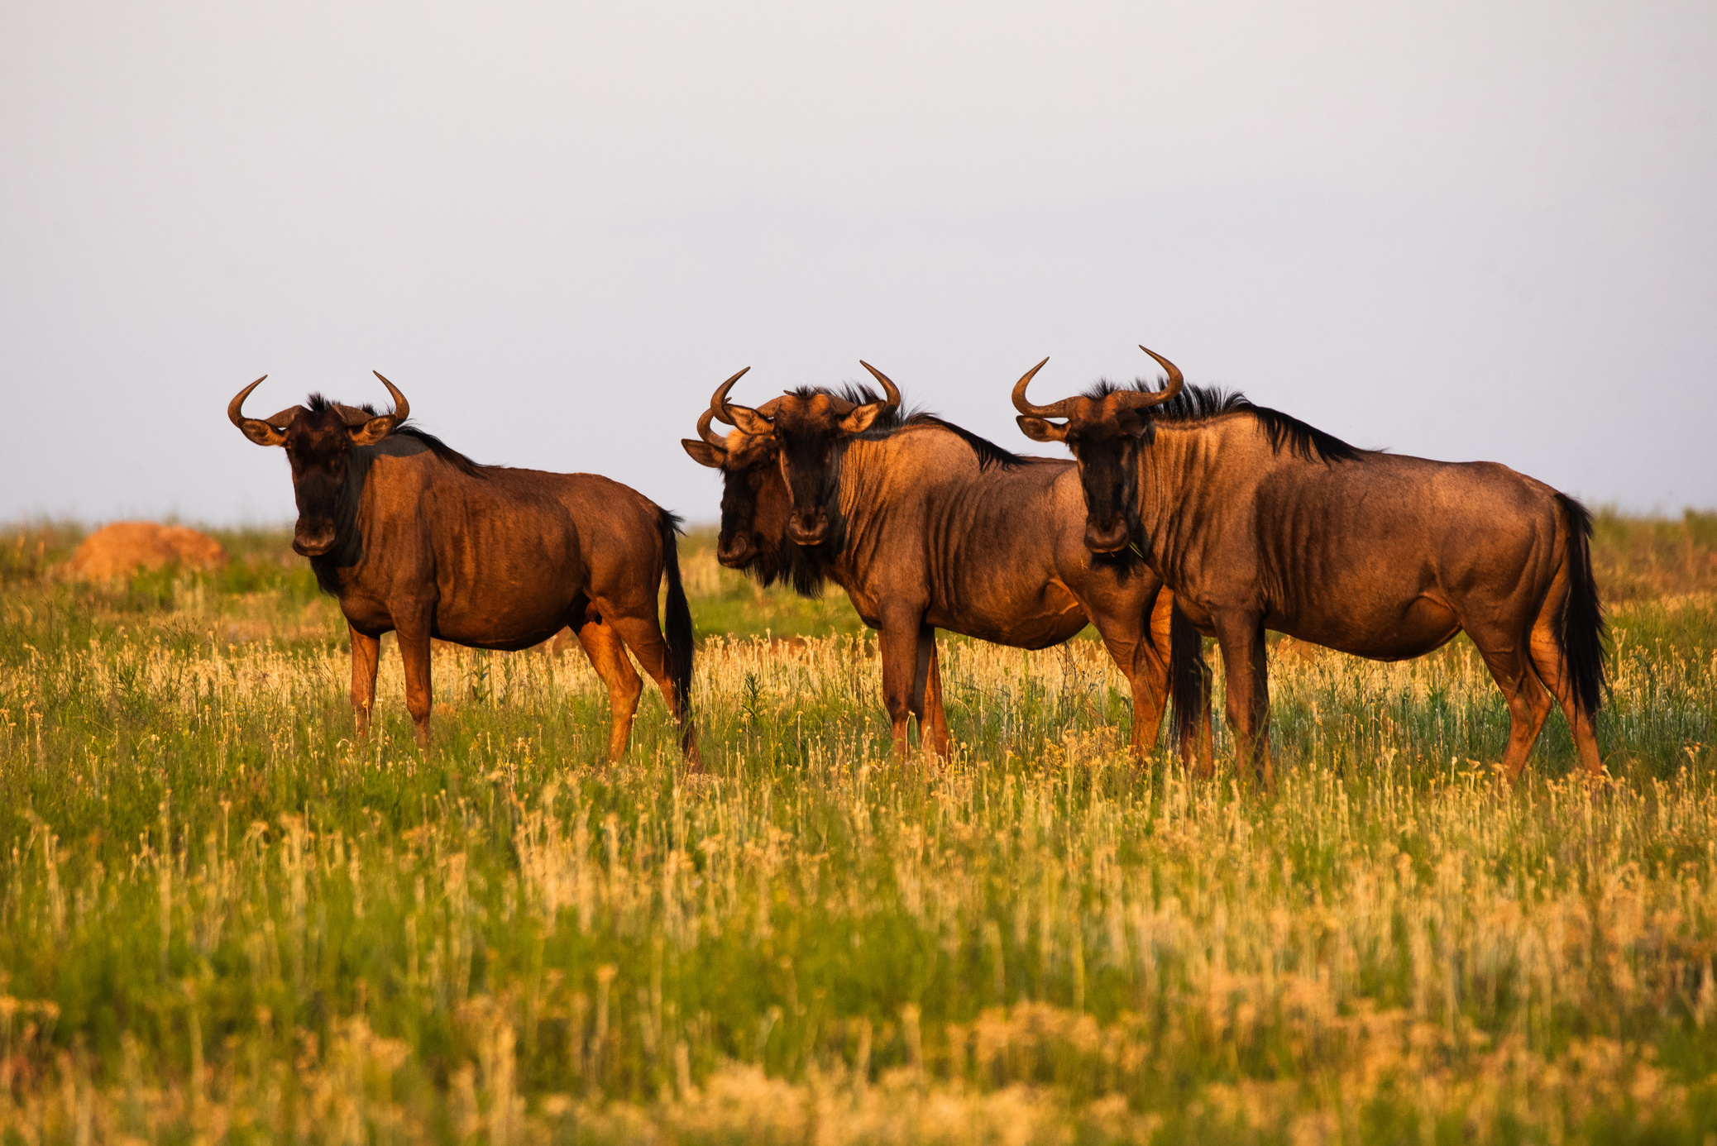
LOT 29
BLUE WILDEBEEST FAMILY
QUANTITY 6
CAPTURE DATES:
MAY 2025
PHOTOS TAKEN AT NAMBITI PRIVATE GAME RESERVE AS EXAMPLES

Slide 30
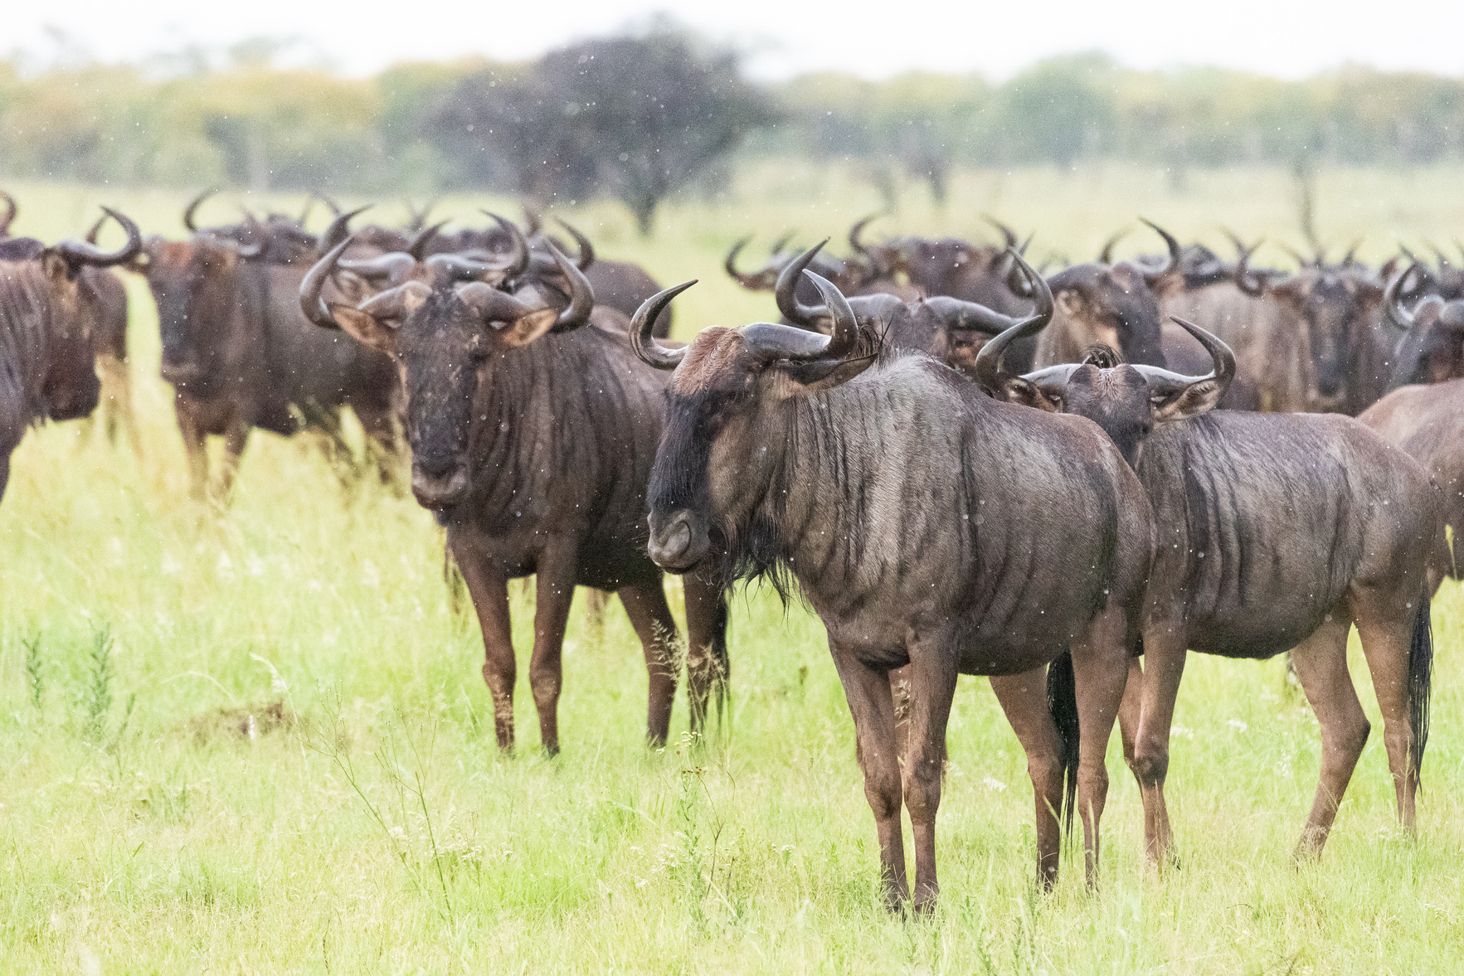
LOT 30
BLUE WILDEBEEST FAMILY
QUANTITY 6
CAPTURE DATES:
MAY 2025
PHOTOS TAKEN AT NAMBITI PRIVATE GAME RESERVE AS EXAMPLES

Slide 31
LOT 31
BLUE WILDEBEEST FAMILY
QUANTITY 6
CAPTURE DATES:
MAY 2025
PHOTOS TAKEN AT NAMBITI PRIVATE GAME RESERVE AS EXAMPLES

Slide 32
LOT 32
BLUE WILDEBEEST FAMILY
QUANTITY 6
CAPTURE DATES:
MAY 2025
PHOTOS TAKEN AT NAMBITI PRIVATE GAME RESERVE AS EXAMPLES

Slide 33
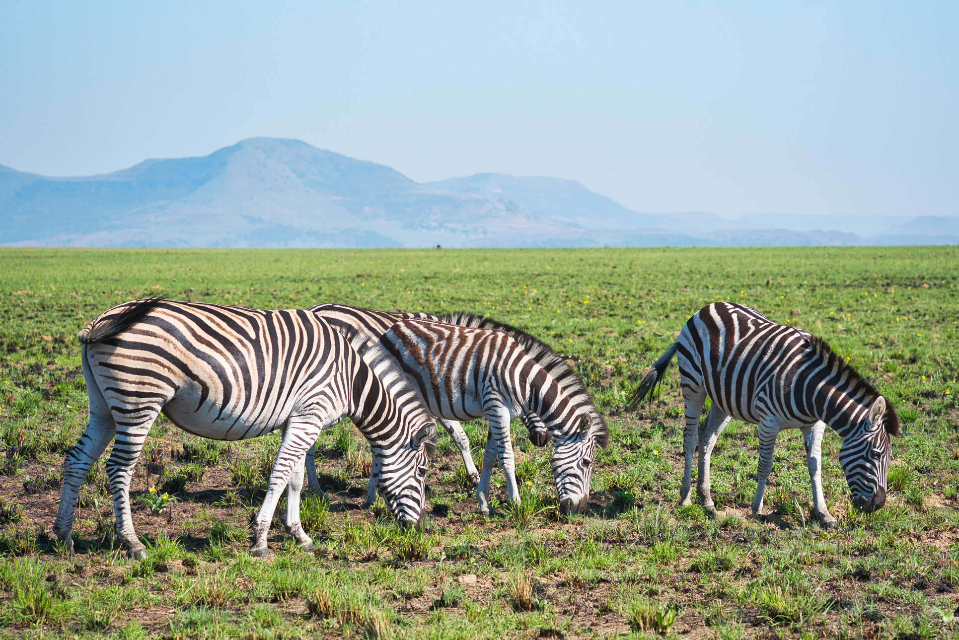
LOT 33
ZEBRA FAMILY GROUP
QUANTITY 6
CAPTURE DATES:
MAY 2025
PHOTOS TAKEN AT NAMBITI PRIVATE GAME RESERVE AS EXAMPLES

Slide 34
LOT 34
ZEBRA FAMILY GROUP
QUANTITY 6
CAPTURE DATES:
MAY 2025
PHOTOS TAKEN AT NAMBITI PRIVATE GAME RESERVE AS EXAMPLES

Slide 35
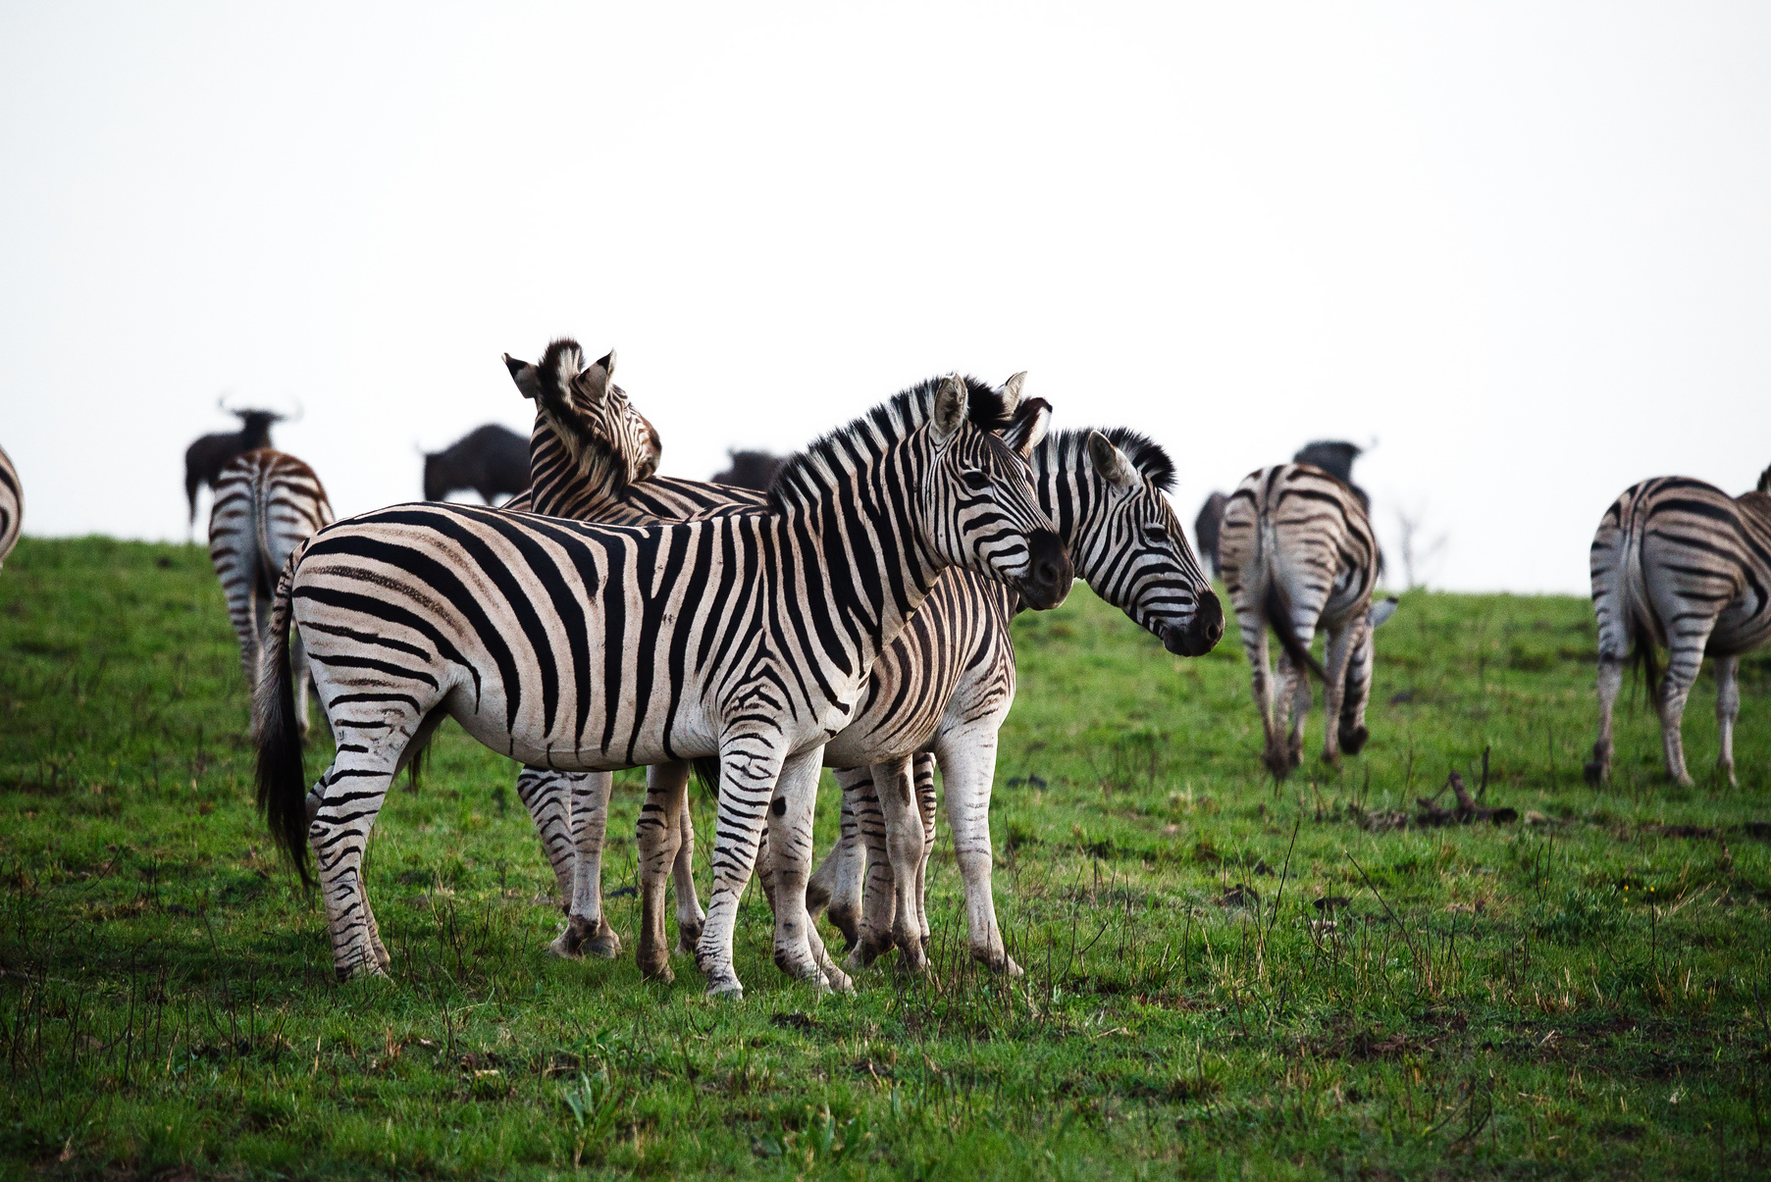
LOT 35
ZEBRA FAMILY GROUP
QUANTITY 6
CAPTURE DATES:
MAY 2025
PHOTOS TAKEN AT NAMBITI PRIVATE GAME RESERVE AS EXAMPLES

Slide 36
LOT 36
KUDU FAMILY GROUP
QUANTITY 8
CAPTURE DATES:
AUGUST 2025
PHOTOS TAKEN AT NAMBITI PRIVATE GAME RESERVE AS EXAMPLES

Slide 37
LOT 37
KUDU FAMILY GROUP
QUANTITY 6
CAPTURE DATES:
AUGUST 2025
PHOTOS TAKEN AT NAMBITI PRIVATE GAME RESERVE AS EXAMPLES

Slide 38
LOT 38
KUDU FAMILY GROUP
QUANTITY 6
CAPTURE DATES:
AUGUST 2025
PHOTOS TAKEN AT NAMBITI PRIVATE GAME RESERVE AS EXAMPLES

Slide 39
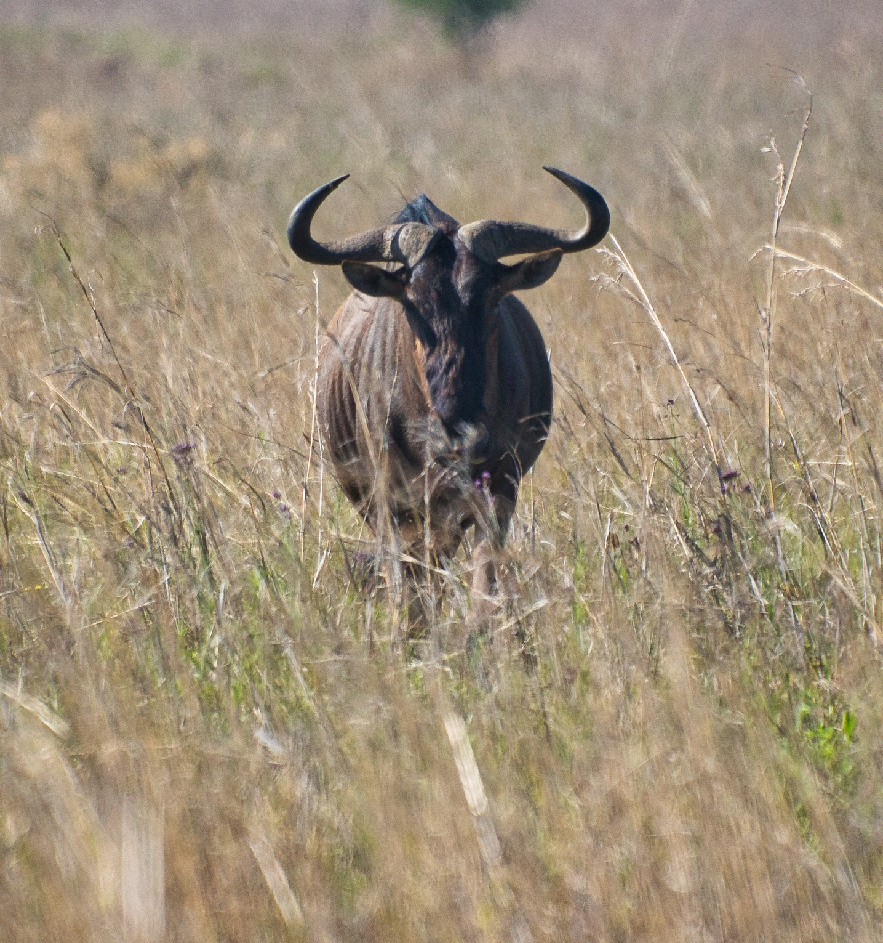
LOT 39
BLUE WILDEBEEST BULL 29'+
QUANTITY 1
CAPTURE DATES:
MAY 2025
PHOTOS TAKEN AT NAMBITI PRIVATE GAME RESERVE AS EXAMPLES

Slide 40
LOT 40
BLUE WILDEBEEST BULL 29'+
QUANTITY 1
CAPTURE DATES:
MAY 2025
PHOTOS TAKEN AT NAMBITI PRIVATE GAME RESERVE AS EXAMPLES

Slide 41
LOT 41
BLUE WILDEBEEST FAMILY
QUANTITY 8
CAPTURE DATES:
MAY 2025
PHOTOS TAKEN AT NAMBITI PRIVATE GAME RESERVE AS EXAMPLES

Slide 42
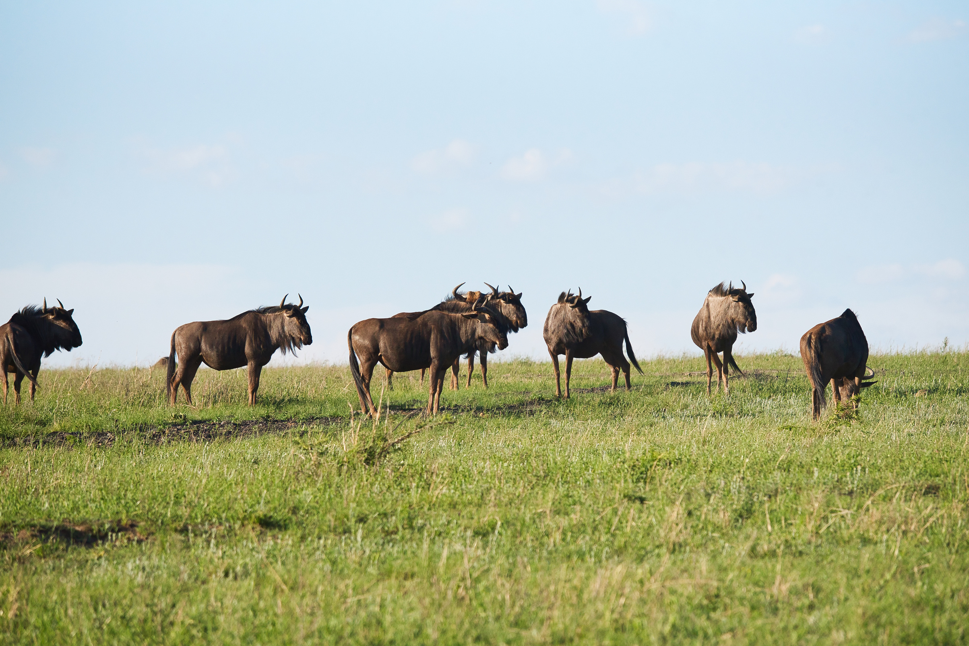
LOT 42
BLUE WILDEBEEST FAMILY
QUANTITY 8
CAPTURE DATES:
MAY 2025
PHOTOS TAKEN AT NAMBITI PRIVATE GAME RESERVE AS EXAMPLES

Slide 43
LOT 43
BLUE WILDEBEEST FAMILY
QUANTITY 8
CAPTURE DATES:
MAY 2025
PHOTOS TAKEN AT NAMBITI PRIVATE GAME RESERVE AS EXAMPLES

Slide 44
LOT 44
BLUE WILDEBEEST FAMILY
QUANTITY 6
CAPTURE DATES:
MAY 2025
PHOTOS TAKEN AT NAMBITI PRIVATE GAME RESERVE AS EXAMPLES

Slide 45
LOT 45
BLUE WILDEBEEST FAMILY
QUANTITY 8
CAPTURE DATES:
MAY 2025
PHOTOS TAKEN AT NAMBITI PRIVATE GAME RESERVE AS EXAMPLES

Slide 46
LOT 46
BLUE WILDEBEEST FAMILY
QUANTITY 6
CAPTURE DATES:
MAY 2025
PHOTOS TAKEN AT NAMBITI PRIVATE GAME RESERVE AS EXAMPLES

Slide 47
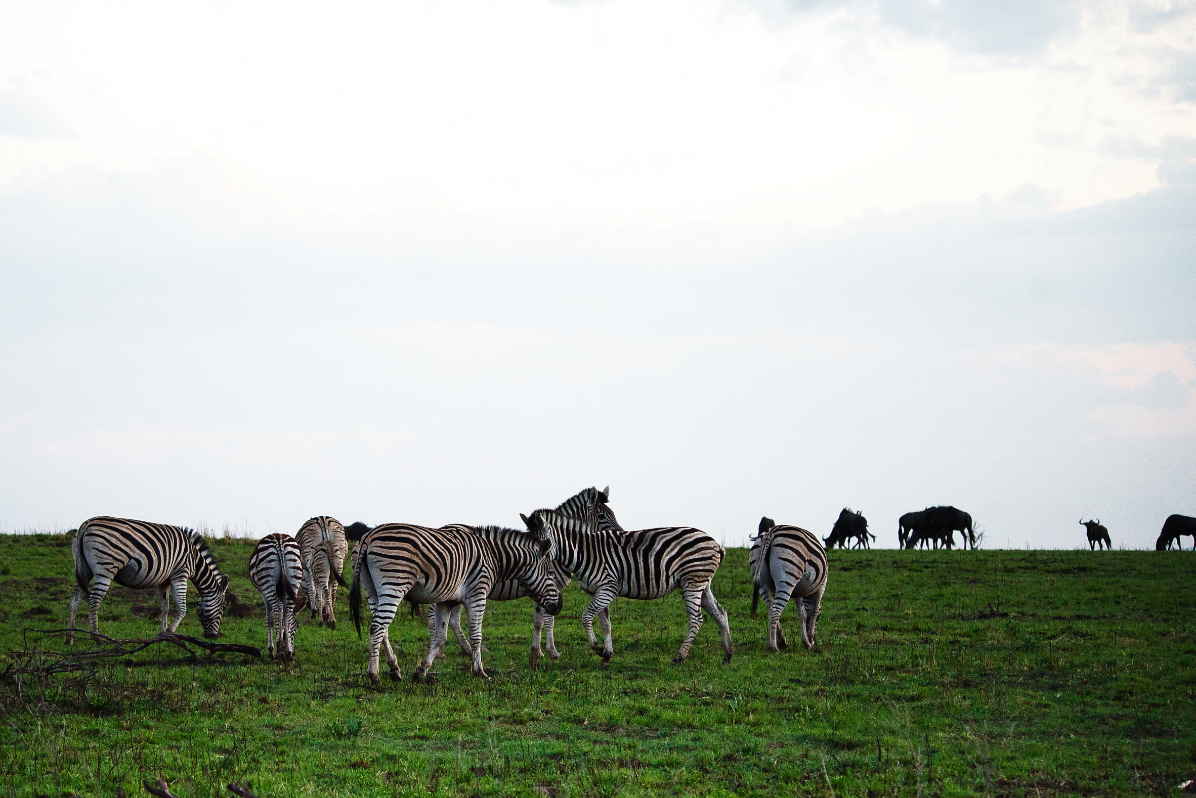
LOT 47
ZEBRA FAMILY GROUP
QUANTITY 6
CAPTURE DATES:
MAY 2025
PHOTOS TAKEN AT NAMBITI PRIVATE GAME RESERVE AS EXAMPLES

Slide 48
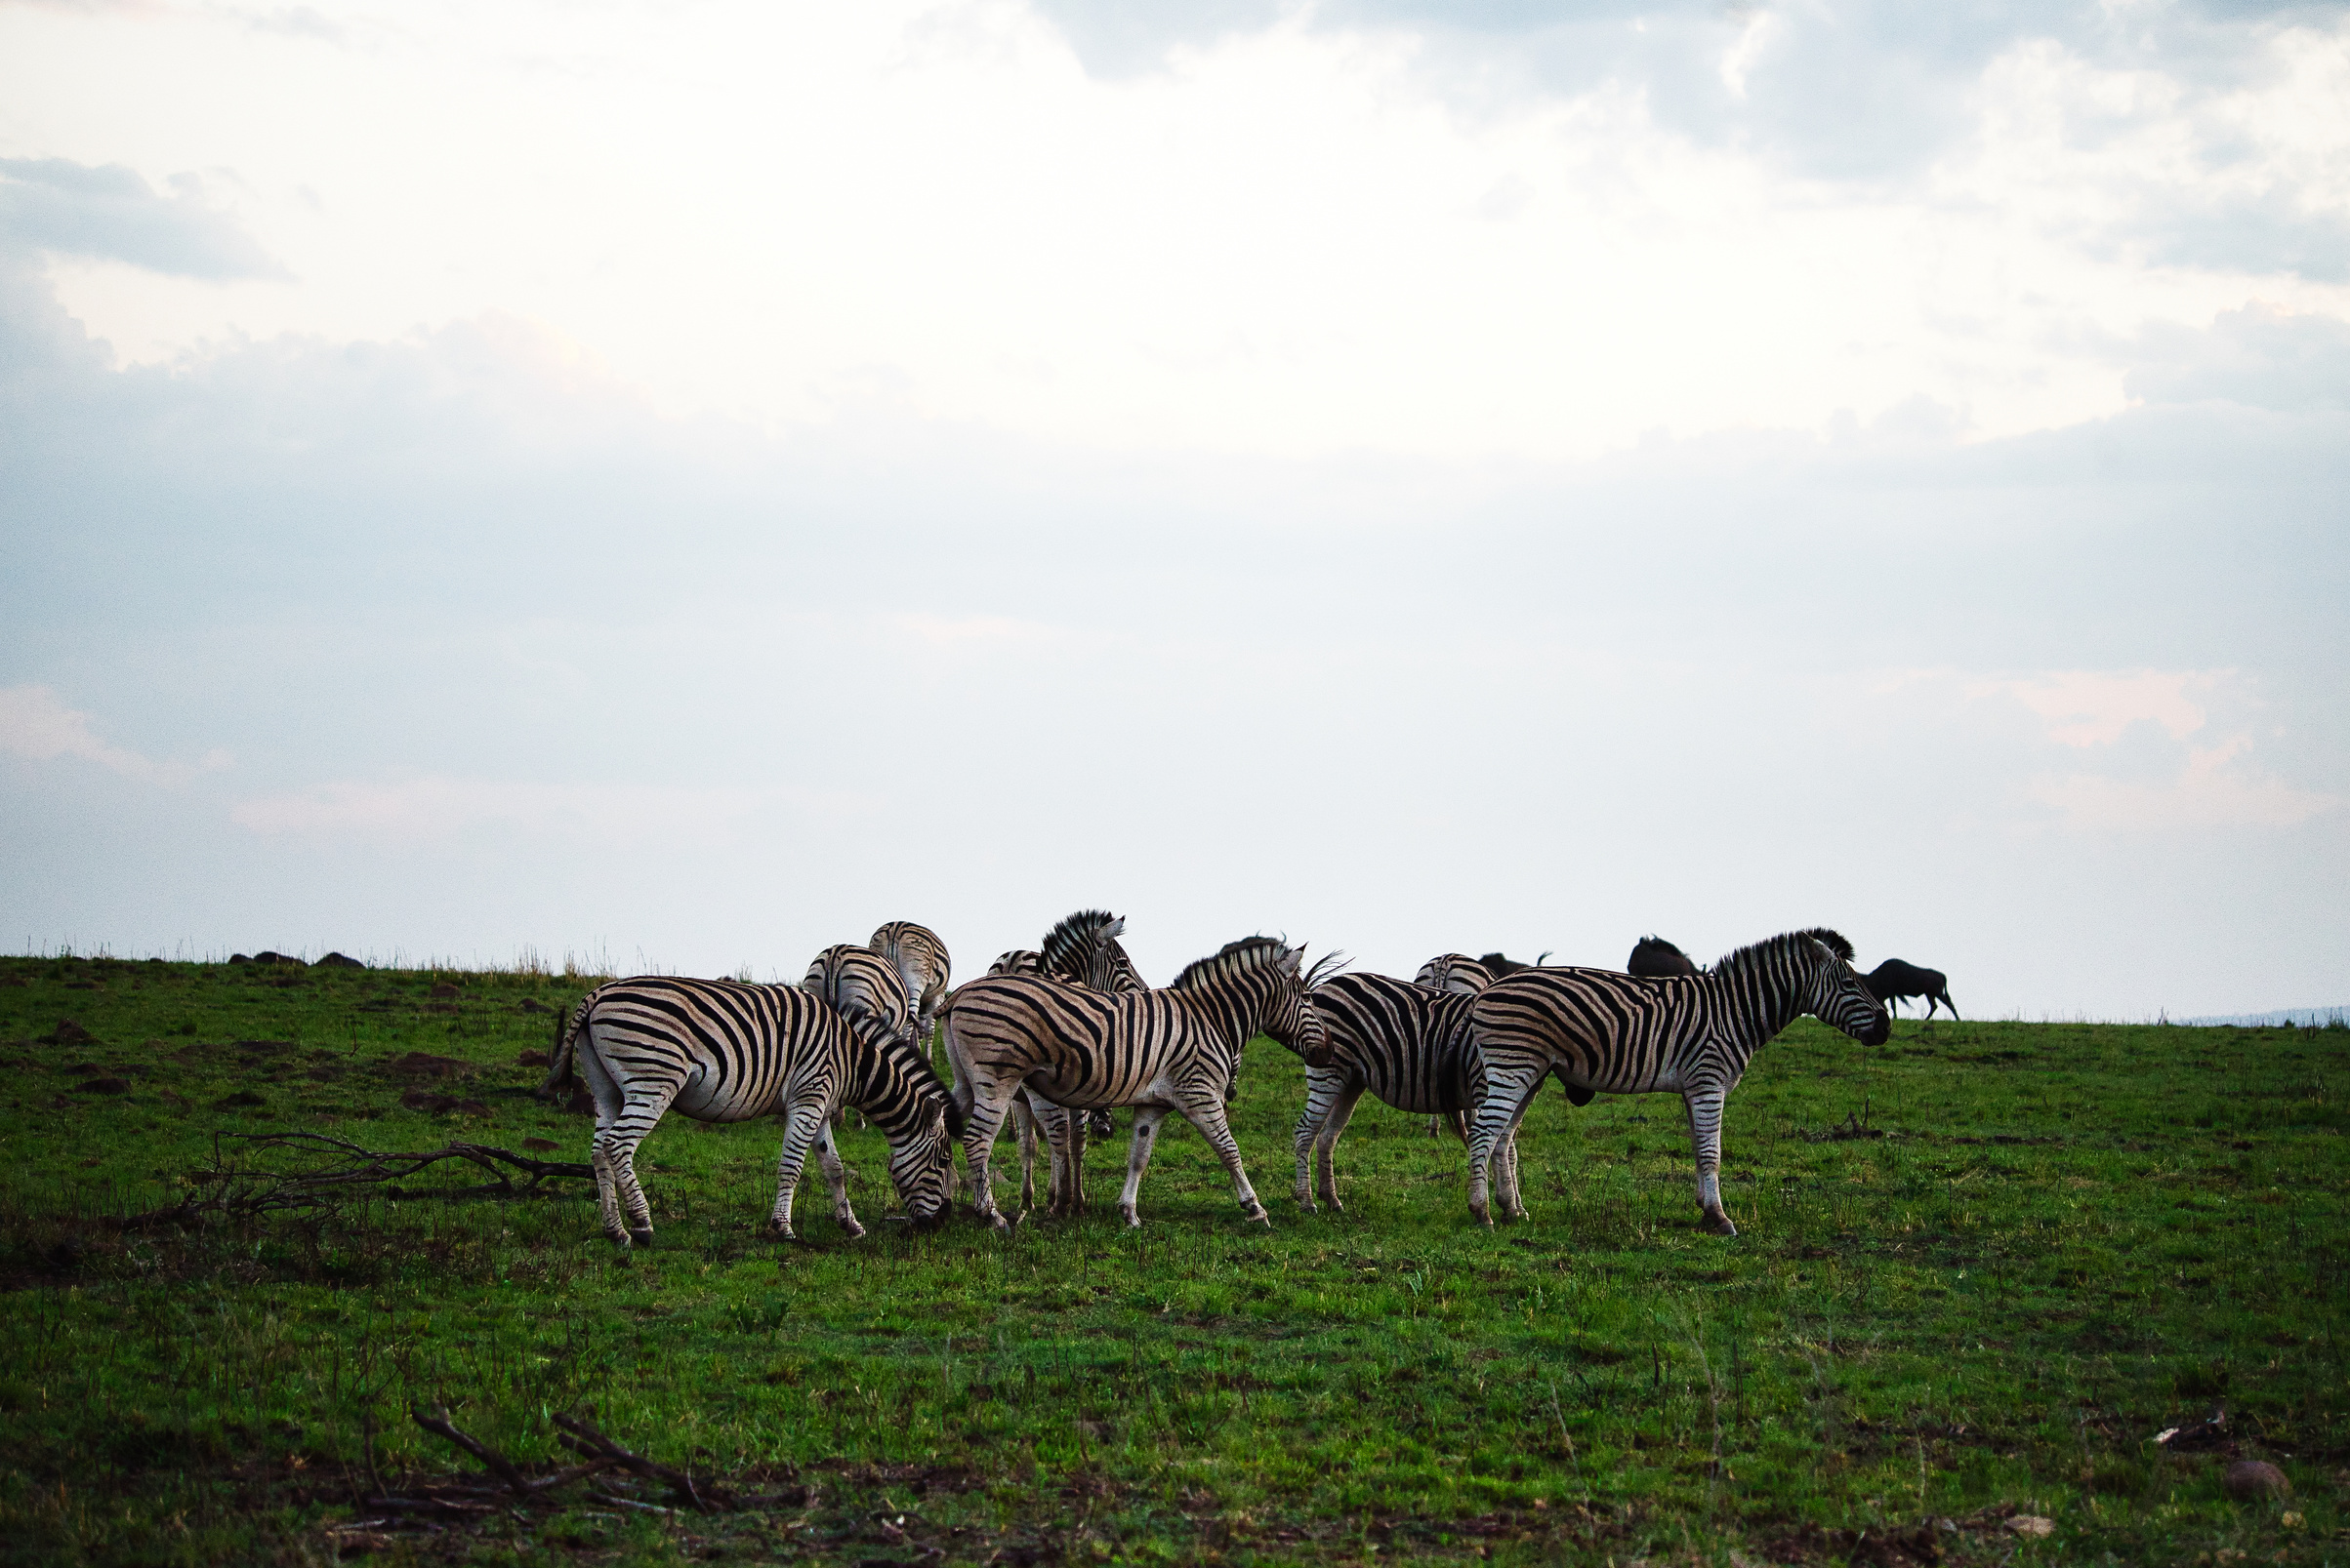
LOT 48
ZEBRA FAMILY GROUP
QUANTITY 6
CAPTURE DATES:
MAY 2025
PHOTOS TAKEN AT NAMBITI PRIVATE GAME RESERVE AS EXAMPLES

Slide 49
LOT 49
ZEBRA FAMILY GROUP
QUANTITY 6
CAPTURE DATES:
MAY 2025
PHOTOS TAKEN AT NAMBITI PRIVATE GAME RESERVE AS EXAMPLES

Slide 50
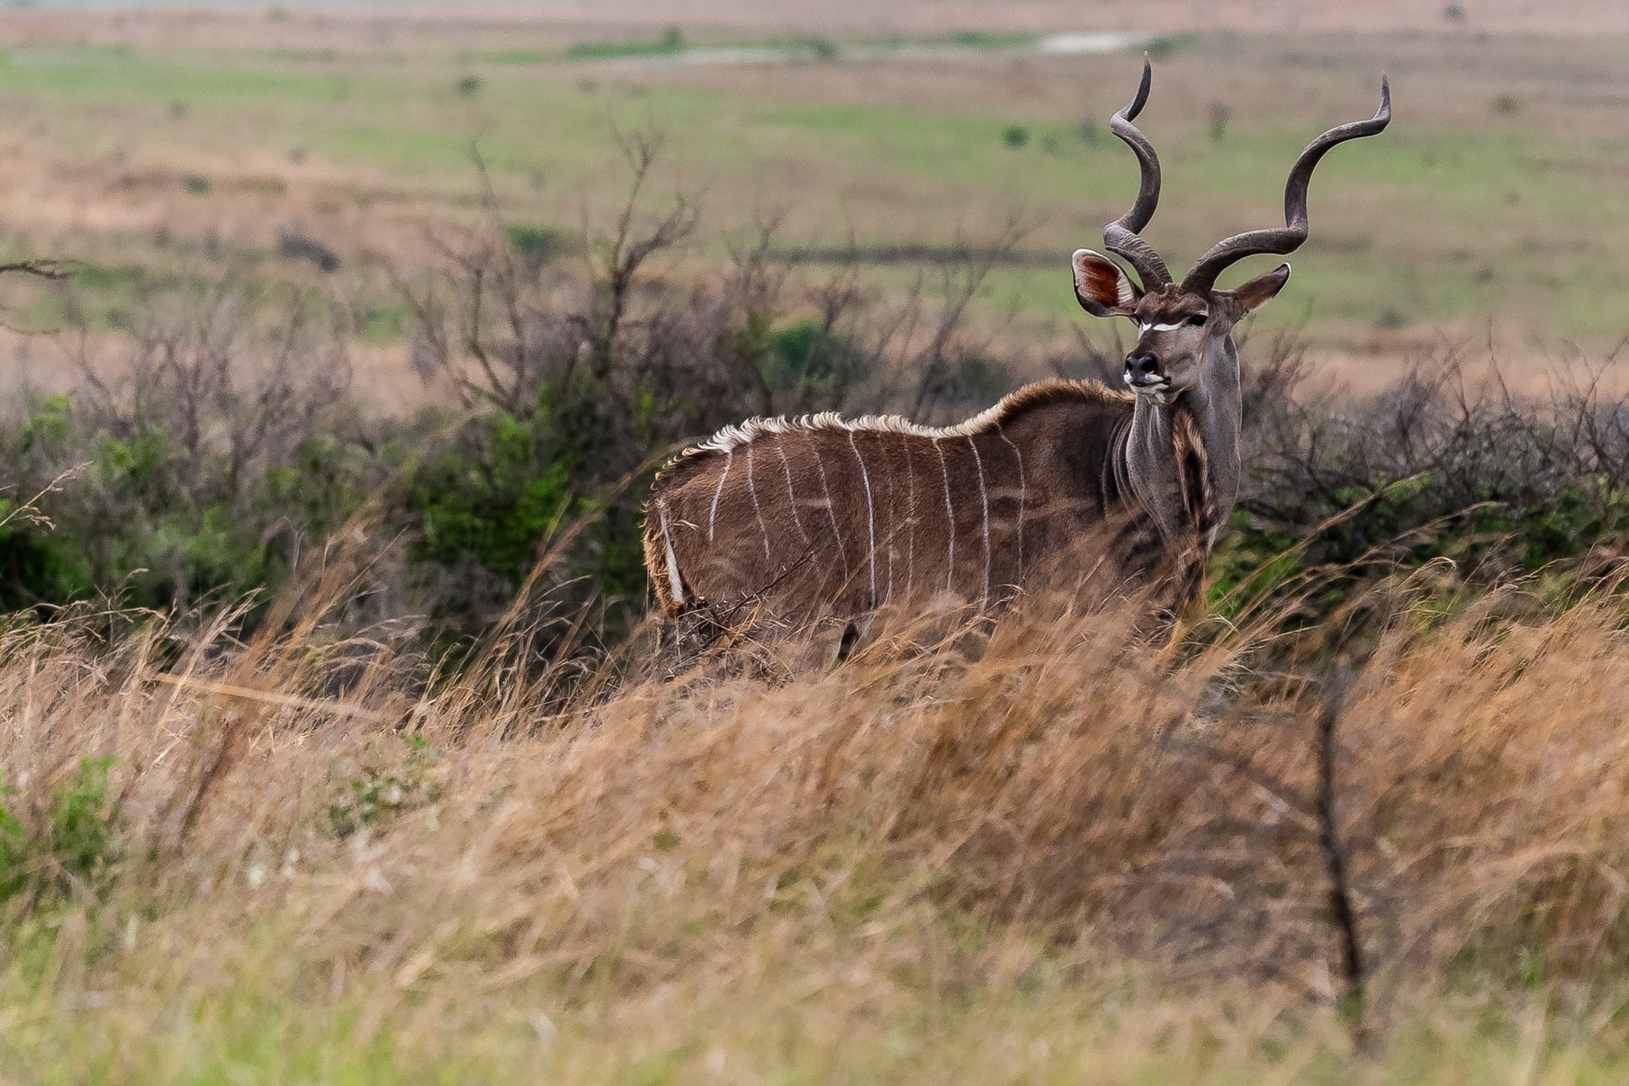
LOT 50
KUDU 50'+
QUANTITY 1
CAPTURE DATES:
MAY 2025
PHOTOS TAKEN AT NAMBITI PRIVATE GAME RESERVE AS EXAMPLES

Slide 51
LOT 51
KUDU FAMILY GROUP
QUANTITY 8
CAPTURE DATES:
AUGUST 2025
PHOTOS TAKEN AT NAMBITI PRIVATE GAME RESERVE AS EXAMPLES

Slide 52
LOT 52
KUDU FAMILY GROUP
QUANTITY 6
CAPTURE DATES:
AUGUST 2025
PHOTOS TAKEN AT NAMBITI PRIVATE GAME RESERVE AS EXAMPLES

Slide 53
LOT 53
KUDU 40' - 45'
QUANTITY 2
CAPTURE DATES:
MAY 2025
PHOTOS TAKEN AT NAMBITI PRIVATE GAME RESERVE AS EXAMPLES

Slide 54
LOT 54
KUDU 40' - 45'
QUANTITY 2
CAPTURE DATES:
MAY 2025
PHOTOS TAKEN AT NAMBITI PRIVATE GAME RESERVE AS EXAMPLES

Slide 55
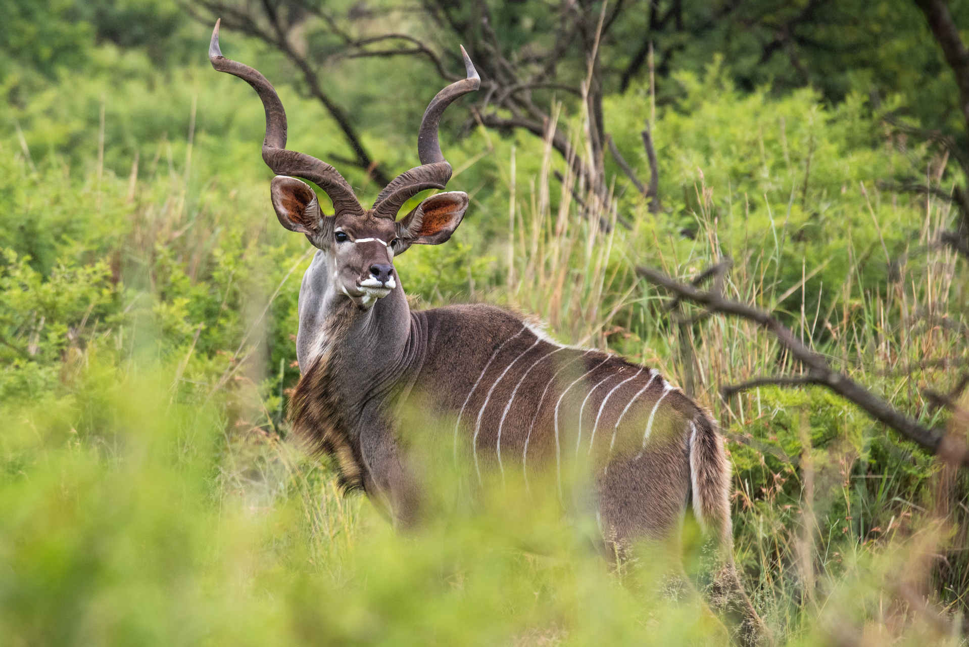
LOT 55
KUDU 40' - 45'
QUANTITY 2
CAPTURE DATES:
MAY 2025
PHOTOS TAKEN AT NAMBITI PRIVATE GAME RESERVE AS EXAMPLES

Slide 56
LOT 56
KUDU 46' - 49'
QUANTITY 2
CAPTURE DATES:
MAY 2025
PHOTOS TAKEN AT NAMBITI PRIVATE GAME RESERVE AS EXAMPLES

Slide 57
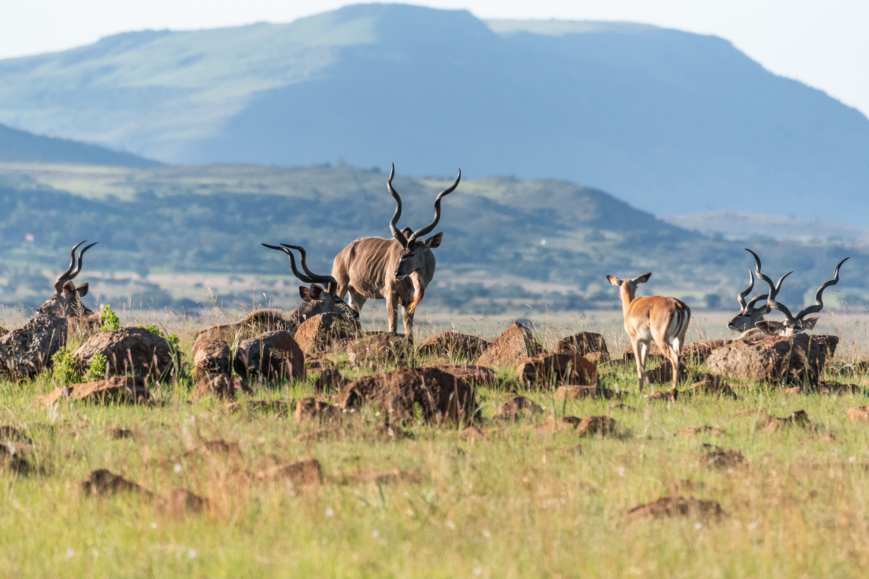
LOT 57
KUDU 46' - 49'
QUANTITY 2
CAPTURE DATES:
MAY 2025
PHOTOS TAKEN AT NAMBITI PRIVATE GAME RESERVE AS EXAMPLES

Slide 58
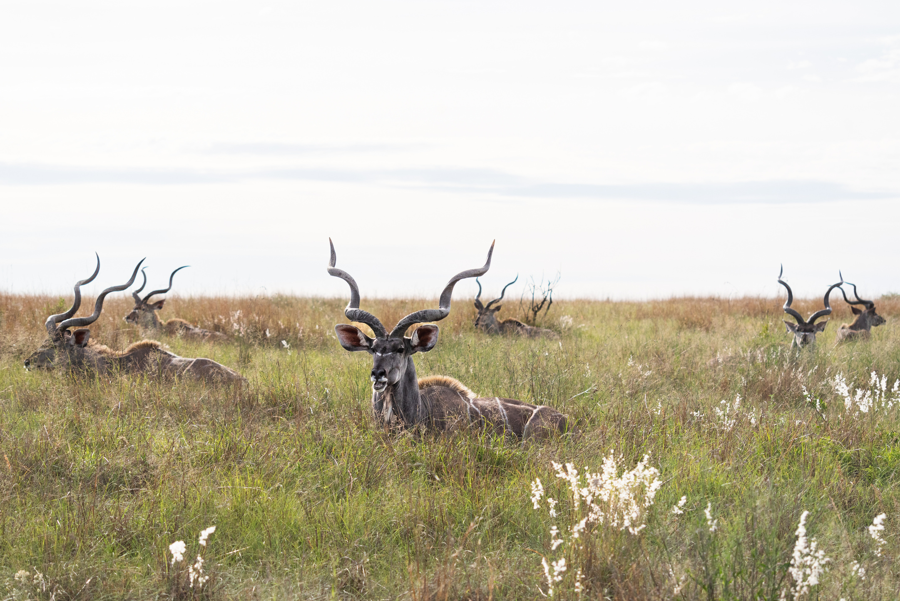
LOT 58
KUDU 46' - 49'
QUANTITY 1
CAPTURE DATES:
MAY 2025
PHOTOS TAKEN AT NAMBITI PRIVATE GAME RESERVE AS EXAMPLES

Slide 59
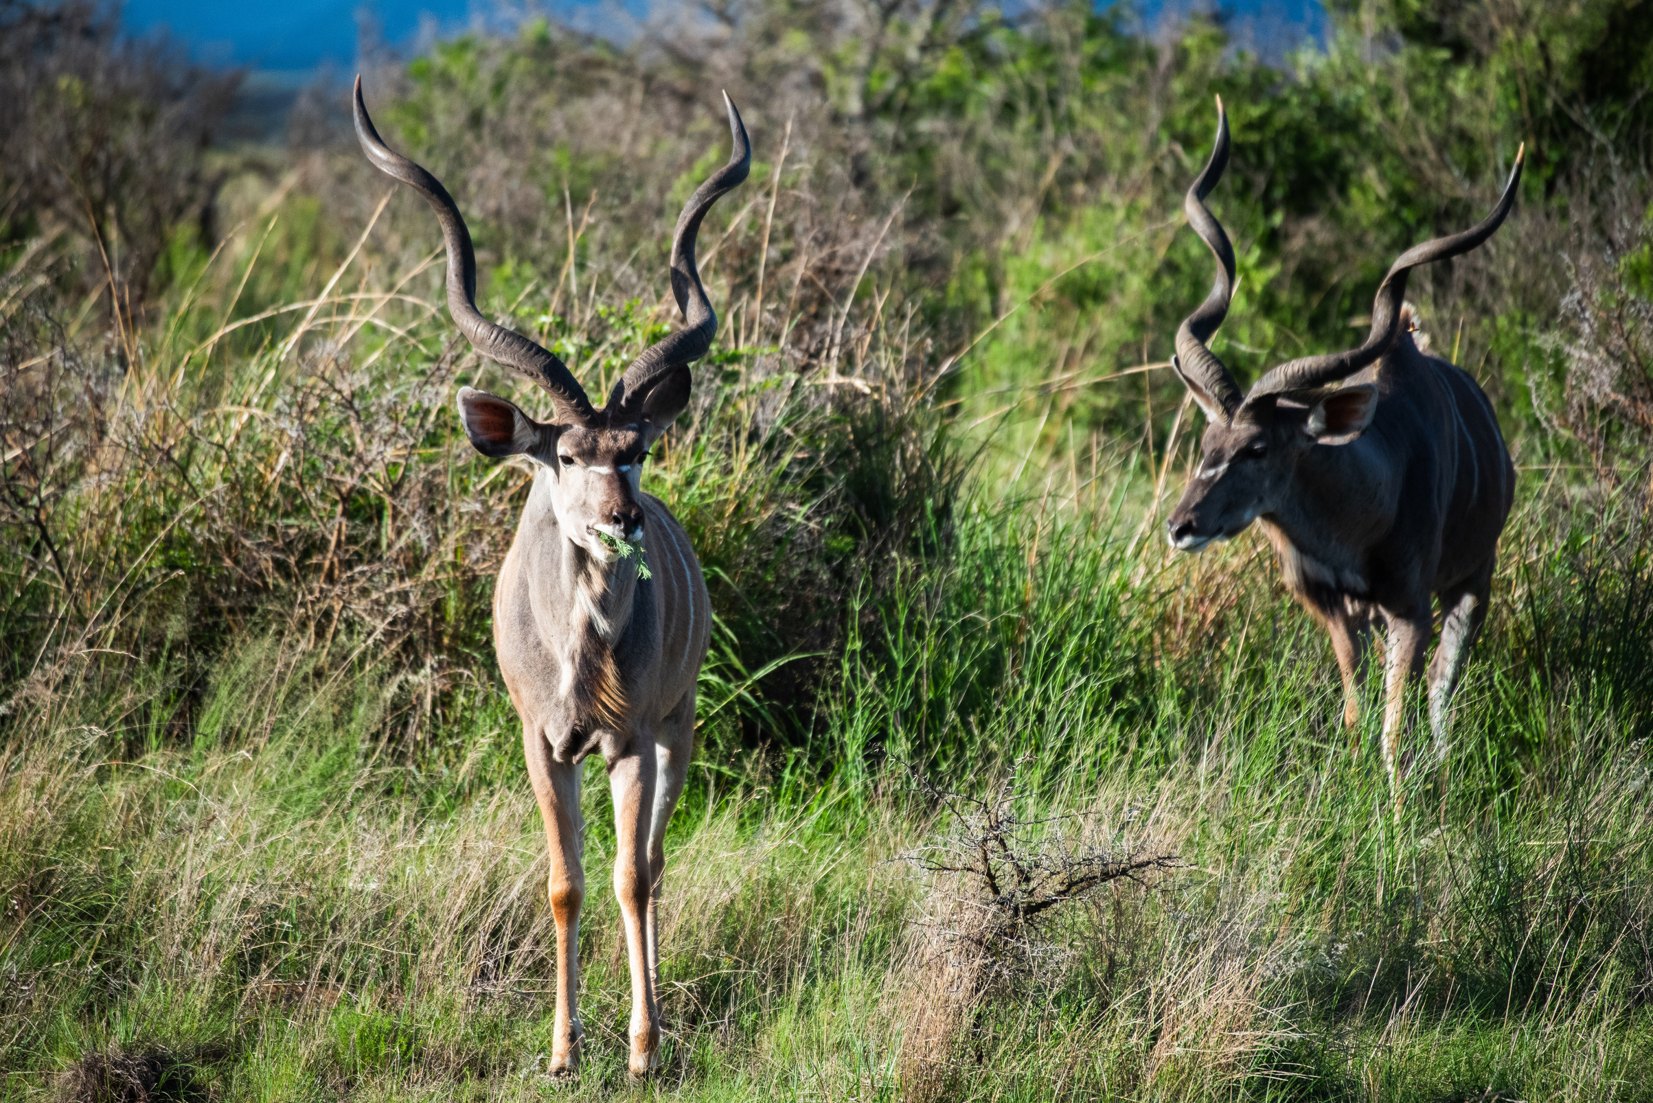
LOT 59
KUDU 46' - 49'
QUANTITY 1
CAPTURE DATES:
MAY 2025
PHOTOS TAKEN AT NAMBITI PRIVATE GAME RESERVE AS EXAMPLES

